Slide 1
JavaScript – Continued..
Instructor: Manu Peethambar
E-mail: cm13055@umbc.edu
Telegram handle: @manupeethambar888
Slides: https://github.com/manupeethambar888/webdev

Slide 2
JavaScript Sorting Arrays
https://www.w3schools.com/js/js_array_sort.asp
JavaScript Array Iteration Methods
Array iteration methods operate on every array item.
https://www.w3schools.com/js/js_array_iteration.asp

Slide 3
JavaScript Booleans
A JavaScript Boolean represents one of two values: true or false.
https://www.w3schools.com/js/js_booleans.asp
JavaScript Comparisons
Comparison and Logical operators are used to test for true or false.
https://www.w3schools.com/js/js_comparisons.asp

Slide 4
JavaScript If...Else Statements
Conditional statements are used to perform different actions based on different conditions: https://www.w3schools.com/js/js_if_else.asp
In JavaScript we have the following conditional statements:
Use if to specify a block of code to be executed, if a specified condition is true
Use else to specify a block of code to be executed, if the same condition is false
Use else if to specify a new condition to test, if the first condition is false
Use switch to specify many alternative blocks of code to be executed

Slide 5
Assignment 15 due – 7/17/2018
Create a sample html file.
Go to the next slide for the question.
Save this as “assignment15.html” in Homework folder in your GitHub repository “Assignments_yourname”.
Commit and push the changes to the repository.

Slide 6
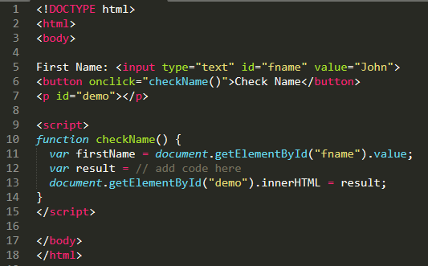
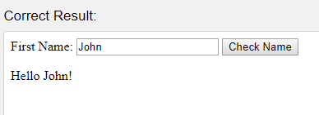
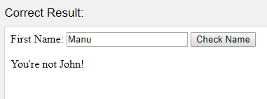
Assignment 15 due – 7/17/2018
Use a conditional (ternary) operator for this exercise: If the variable firstName is equal to "John", the value of the variable result should be "Hello John!", otherwise the value of result should be "You're not John!".

Slide 7
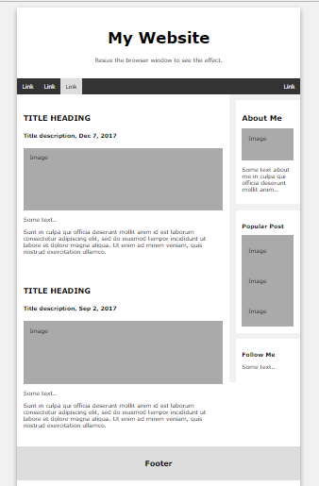
Project Assignment
You have to save the below assignment in your project folder.
Replace the text and fill your relevant information into the elements in index.html
Add relevant images.

